Slide 1
A MATERIAL DESIGN STUDY APP

Slide 2

DESCRIPTION
Unlock your learning potential with Material Study, an innovative educational app designed with Google's Material Design principles. Our app provides a seamless user experience, combining visually appealing interfaces with intuitive navigation.
Features include:
Interactive Study Guides: Dive into comprehensive study materials that are easy to read and visually engaging, enhancing retention.
Customizable Study Plans: Adapt your learning schedule with personalized plans, allowing you to set and track your goals effectively.
Progress Tracking: Monitor your advancement with dashboards that visualize your achievements and areas for improvement.
Collaborative Learning: Join study groups, share resources, and connect with peers to foster a dynamic learning community.
Engaging Quizzes and Flashcards: Test your knowledge and reinforce learning with interactive quizzes and flashcards designed with smart algorithms.

Slide 3
Color.kt
package com.example.owlapplication.ui.theme
import androidx.compose.ui.graphics.Color
val Purple200 = Color(0xFFBB86FC)
val Purple500 = Color(0xFF6200EE)
val Purple700 = Color(0xFF3700B3)
val Teal200 = Color(0xFF03DAC5)
Shape.kt
package com.example.owlapplication.ui.theme
importandroidx.compose.foundation.shape.RoundedCornerShape
import androidx.compose.material.Shapes
import androidx.compose.ui.unit.dp
val Shapes = Shapes(
small = RoundedCornerShape(4.dp),
medium = RoundedCornerShape(4.dp),
large = RoundedCornerShape(0.dp)
)

Slide 4
Theme.kt
package com.example.owlapplication.ui.theme
import androidx.compose.foundation.isSystemInDarkTheme
import androidx.compose.material.MaterialTheme
import androidx.compose.material.darkColors
import androidx.compose.material.lightColors
import androidx.compose.runtime.Composable
private val DarkColorPalette = darkColors(
primary = Purple200,
primaryVariant = Purple700,
secondary = Teal200
)
private val LightColorPalette = lightColors(
primary = Purple500,
primaryVariant = Purple700,
secondary = Teal200

Slide 5
)
@Composable
fun OwlApplicationTheme(
darkTheme: Boolean = isSystemInDarkTheme(),
content: @Composable () -> Unit
) {
val colors = if (darkTheme) {
DarkColorPalette
} else {
LightColorPalette
}

Slide 6
MainActivity.kt
package com.example.owlapplication
import android.content.Context
import android.content.Intent
import android.os.Bundle
import androidx.activity.ComponentActivity
import androidx.activity.compose.setContent
import androidx.compose.foundation.Image
import androidx.compose.foundation.clickable
import androidx.compose.foundation.layout.*
import androidx.compose.foundation.rememberScrollState
import androidx.compose.foundation.verticalScroll
import androidx.compose.material.Card
import androidx.compose.material.Text
import androidx.compose.runtime.Composable
import androidx.compose.ui.Alignment
import androidx.compose.ui.Modifier
import androidx.compose.ui.draw.scale
import androidx.compose.ui.graphics.Color
import androidx.compose.ui.res.painterResource
import androidx.compose.ui.res.stringResource
import androidx.compose.ui.text.font.FontWeight
import androidx.compose.ui.text.style.TextAlign
import androidx.compose.ui.unit.dp
import androidx.compose.ui.unit.sp
class MainActivity : ComponentActivity() {
override fun onCreate(savedInstanceState: Bundle?) {
super.onCreate(savedInstanceState)
setContent {
StudyApp(this)
}
}
}
@Composable
fun StudyApp(context: Context) {
Column(
modifier = Modifier
.padding(20.dp)
.verticalScroll(rememberScrollState())
) {
Text(text = "Study Material",
fontSize = 36.sp,
fontWeight = FontWeight.Bold,
color = Color(0xFFFFA500),
modifier = Modifier.align(Alignment.CenterHorizontally))
Spacer(modifier = Modifier.height(20.dp))
// 01
Card(
modifier = Modifier
.fillMaxWidth()
.height(250.dp)
.clickable {
context.startActivity(
Intent(context, MainActivity2::class.java)
)
},
elevation = 8.dp
)
{
Column(
horizontalAlignment = Alignment.CenterHorizontally
) {
Image(
painterResource(id = R.drawable.img_1), contentDescription = "",
modifier = Modifier
.height(150.dp)
.scale(scaleX = 1.2F, scaleY = 1F)
)
Text(text = stringResource(id = R.string.course1),color = Color(0xFFFFA500),
fontSize = 16.sp)
Text(
text = stringResource(id = R.string.topic1),
fontWeight = FontWeight.Bold,
fontSize = 20.sp,
textAlign = TextAlign.Center,
)
}
}
Spacer(modifier = Modifier.height(20.dp))
// 02
Card(
modifier = Modifier
.fillMaxWidth()
.height(250.dp)
.clickable {
context.startActivity(
Intent(context, MainActivity3::class.java)
)
},
elevation = 8.dp
)
{
Column(
horizontalAlignment = Alignment.CenterHorizontally
) {
Image(
painterResource(id = R.drawable.img_2), contentDescription = "",
modifier = Modifier
.height(150.dp)
.scale(scaleX = 1.4F, scaleY = 1F)
)
Text(text = stringResource(id = R.string.course2),color = Color(0xFFFFA500),
fontSize = 16.sp)
Text(
text = stringResource(id = R.string.topic2),
fontWeight = FontWeight.Bold,
fontSize = 20.sp,
textAlign = TextAlign.Center,
)
}
}
Spacer(modifier = Modifier.height(20.dp))
// 03
Card(
modifier = Modifier
.fillMaxWidth()
.height(250.dp)
.clickable {
context.startActivity(
Intent(context, MainActivity4::class.java)
)
},
elevation = 8.dp
)
{
Column(
horizontalAlignment = Alignment.CenterHorizontally
) {
Image(
painterResource(id = R.drawable.img_3), contentDescription = "",
modifier = Modifier
.height(150.dp)
.scale(scaleX = 1.2F, scaleY = 1F)
)
Text(text = stringResource(id = R.string.course3),color = Color(0xFFFFA500),
fontSize = 16.sp)
Text(
text = stringResource(id = R.string.topic3),
fontWeight = FontWeight.Bold,
fontSize = 20.sp,
textAlign = TextAlign.Center,
)
}
}
Spacer(modifier = Modifier.height(20.dp))
// 04
Card(
modifier = Modifier
.fillMaxWidth()
.height(250.dp)
.clickable {
context.startActivity(
Intent(context, MainActivity5::class.java)
)
},
elevation = 8.dp
)
{
Column(
horizontalAlignment = Alignment.CenterHorizontally
) {
Image(
painterResource(id = R.drawable.img_4), contentDescription = "",
modifier = Modifier
.height(150.dp)
.scale(scaleX = 1.2F, scaleY = 1F)
)
Text(text = stringResource(id = R.string.course4),color = Color(0xFFFFA500),
fontSize = 16.sp)
Text(
text = stringResource(id = R.string.topic4),
fontWeight = FontWeight.Bold,
fontSize = 20.sp,
textAlign = TextAlign.Center,
)
}
}
}
}

Slide 7
import androidx.compose.ui.res.painterResource
import androidx.compose.ui.res.stringResource
import androidx.compose.ui.text.font.FontWeight
import androidx.compose.ui.text.style.TextAlign
import androidx.compose.ui.unit.dp
import androidx.compose.ui.unit.sp
class MainActivity : ComponentActivity() {
override fun onCreate(savedInstanceState: Bundle?) {
super.onCreate(savedInstanceState)
setContent {
StudyApp(this)
}
}
}
@Composable
fun StudyApp(context: Context) {

Slide 8
Column(
modifier = Modifier
.padding(20.dp)
.verticalScroll(rememberScrollState())
) {
Text(text = "Study Material",
fontSize = 36.sp,
fontWeight = FontWeight.Bold,
color = Color(0xFFFFA500),
modifier = Modifier.align(Alignment.CenterHorizontally))
Spacer(modifier = Modifier.height(20.dp))
// 01
Card(
modifier = Modifier

Slide 9
.fillMaxWidth()
.height(250.dp)
.clickable {
context.startActivity(
Intent(context, MainActivity2::class.java)
)
},
elevation = 8.dp
)
{
Column(
horizontalAlignment = Alignment.CenterHorizontally
) {
Image(
painterResource(id = R.drawable.img_1), contentDescription = "",
modifier = Modifier
.height(150.dp)
.scale(scaleX = 1.2F, scaleY = 1F)
)

Slide 10
Text(text = stringResource(id = R.string.course1),color = Color(0xFFFFA500),
fontSize = 16.sp)
Text(
text = stringResource(id = R.string.topic1),
fontWeight = FontWeight.Bold,
fontSize = 20.sp,
textAlign = TextAlign.Center,
)
}
}
Spacer(modifier = Modifier.height(20.dp))
// 02
Card(
modifier = Modifier
.fillMaxWidth()
.height(250.dp)
.clickable {

Slide 11
context.startActivity(
Intent(context, MainActivity3::class.java)
)
},
elevation = 8.dp
)
{
Column(
horizontalAlignment = Alignment.CenterHorizontally
) {
Image(
painterResource(id = R.drawable.img_2), contentDescription = "",
modifier = Modifier
.height(150.dp)
.scale(scaleX = 1.4F, scaleY = 1F)
)
Text(text = stringResource(id = R.string.course2),color = Color(0xFFFFA500),
fontSize = 16.sp)

Slide 12
Text(
text = stringResource(id = R.string.topic2),
fontWeight = FontWeight.Bold,
fontSize = 20.sp,
textAlign = TextAlign.Center,
)
}
}
Spacer(modifier = Modifier.height(20.dp))
// 03
Card(
modifier = Modifier
.fillMaxWidth()
.height(250.dp)
.clickable {
context.startActivity(
Intent(context, MainActivity4::class.java
)

Slide 13
},
elevation = 8.dp
)
{
Column(
horizontalAlignment = Alignment.CenterHorizontally
) {
Image(
painterResource(id = R.drawable.img_3), contentDescription = "",
modifier = Modifier
.height(150.dp)
.scale(scaleX = 1.2F, scaleY = 1F)
)
Text(text = stringResource(id = R.string.course3),color = Color(0xFFFFA500),
fontSize = 16.sp)
Text(
text = stringResource(id = R.string.topic3),
fontWeight = FontWeight.Bold,

Slide 14
fontSize = 20.sp,
textAlign = TextAlign.Center,
)
}
}
Spacer(modifier = Modifier.height(20.dp))
// 04
Card(
modifier = Modifier
.fillMaxWidth()
.height(250.dp)
.clickable {
context.startActivity(
Intent(context, MainActivity5::class.java)
)
},
elevation = 8.dp
)
{
Column(
horizontalAlignment = Alignment.CenterHorizontally
) {
Image(
painterResource(id = R.drawable.img_4), contentDescription = "",
modifier = Modifier
.height(150.dp)
.scale(scaleX = 1.2F, scaleY = 1F)
)
Text(text = stringResource(id = R.string.course4),color = Color(0xFFFFA500),
fontSize = 16.sp)
Text(
text = stringResource(id = R.string.topic4),
fontWeight = FontWeight.Bold,
fontSize = 20.sp,
textAlign = TextAlign.Center,
)
}
}
}
}

Slide 15
)
},
elevation = 8.dp
)
{
Column(
horizontalAlignment = Alignment.CenterHorizontally
) {
Image(
painterResource(id = R.drawable.img_4), contentDescription = "",
modifier = Modifier
.height(150.dp)
.scale(scaleX = 1.2F, scaleY = 1F)
)
Text(text = stringResource(id = R.string.course4),color = Color(0xFFFFA500),
fontSize = 16.sp)
Text(
text = stringResource(id = R.string.topic4),
fontWeight = FontWeight.Bold,
fontSize = 20.sp,
textAlign = TextAlign.Center,
)
}
}
}
}

Slide 16
Text(
text = stringResource(id = R.string.topic4),
fontWeight = FontWeight.Bold,
fontSize = 20.sp,
textAlign = TextAlign.Center,
)
}
}
}
}

Slide 17
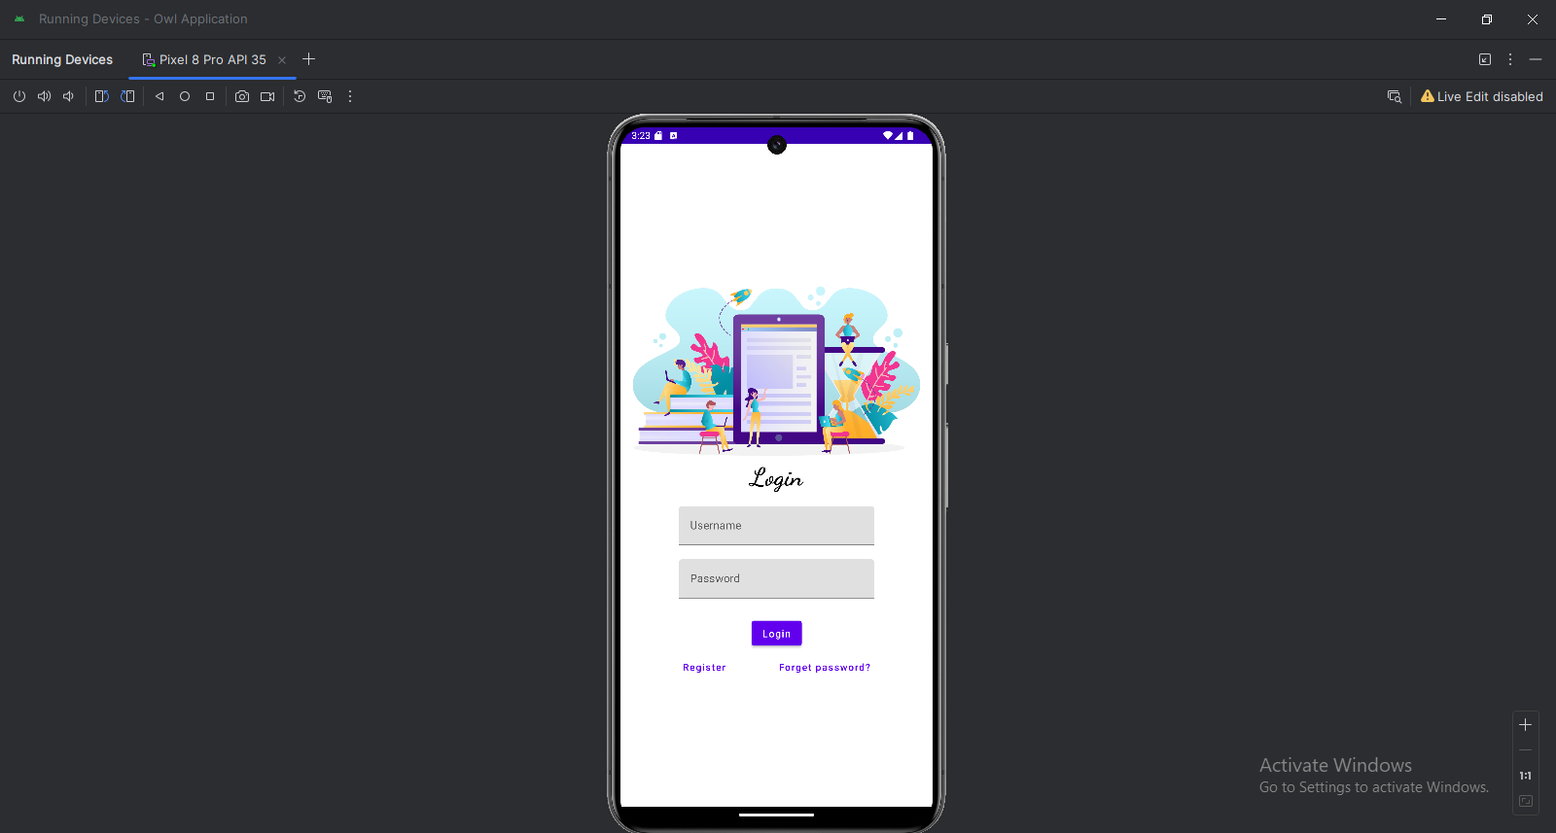
OUTPUT:

Slide 18
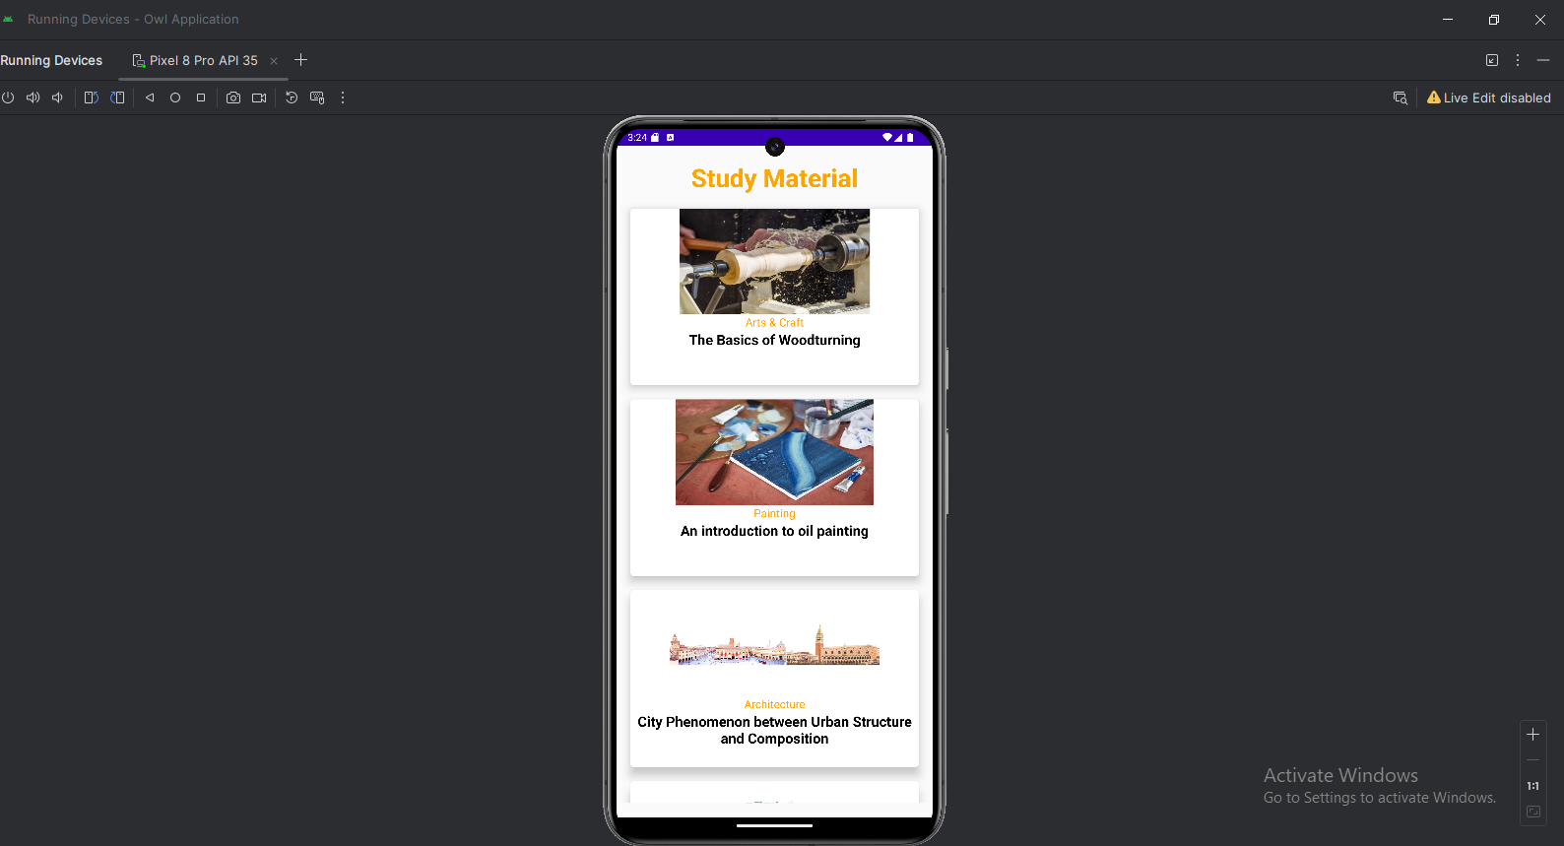
OUTPUT:

Slide 19

OUTPUT:

